Slide 1




FORMAL RESEARCH PAPER PRESENTATION

Slide 2

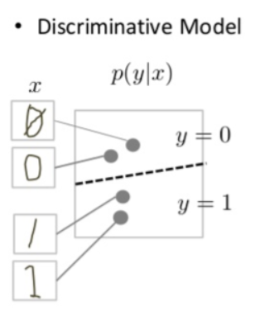
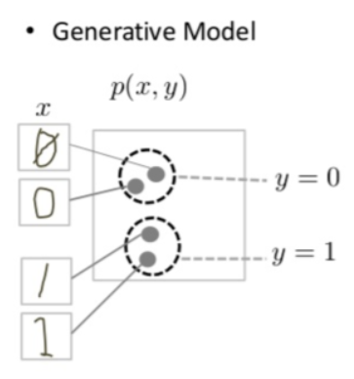

Water Crystal Synthesis
Authors:
Ashraf – 196280
Farah – 194233
Mohamed – 206069
Surveying Generative DL Models
Supervised By:
Dr. Andreas Pester
TA Amgad

Slide 3

Agenda Items
Defining Generative Models
Generative Adversarial Networks
Variational Autoencoders
Diffusion Models
Comparative Analysis
Conclusion

Slide 4

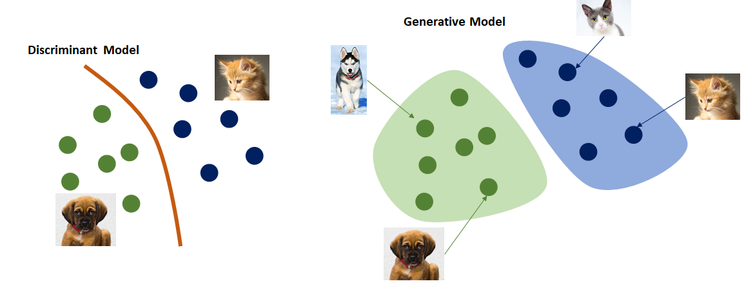
Introduction
What are Generative Models?

Slide 6

GANs
What are Generative Adversarial Networks?

Slide 8
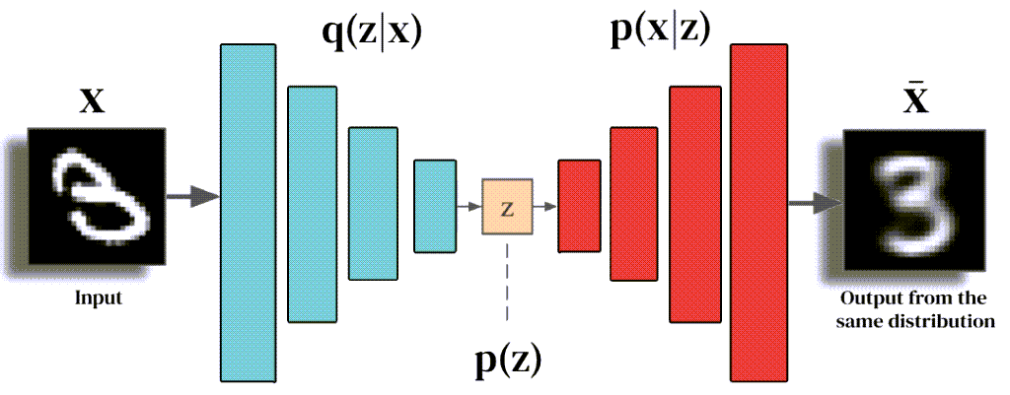
VAs
What are Variational Autencoders?

Slide 10
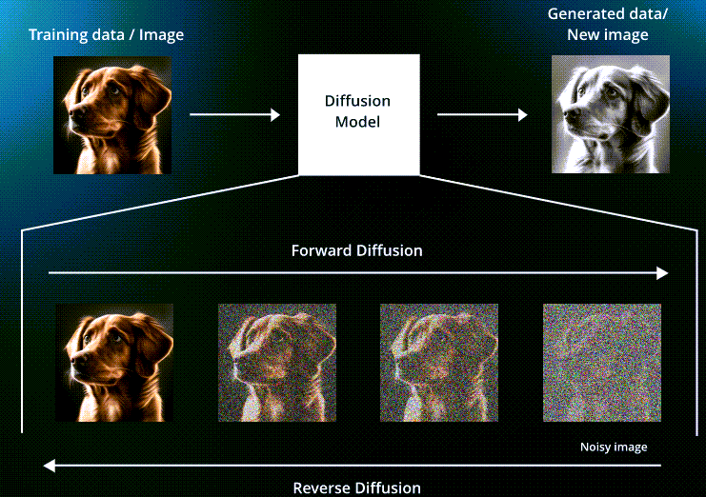
DMs
What are Diffusion Models?

Slide 12
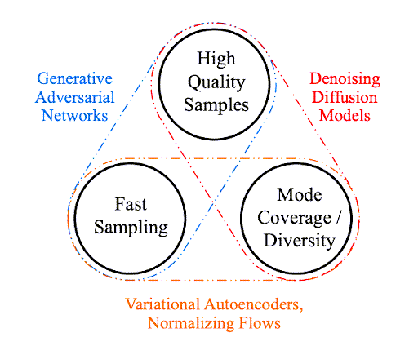
Comparative Analysis
Is there a “best” generative model?

Slide 14
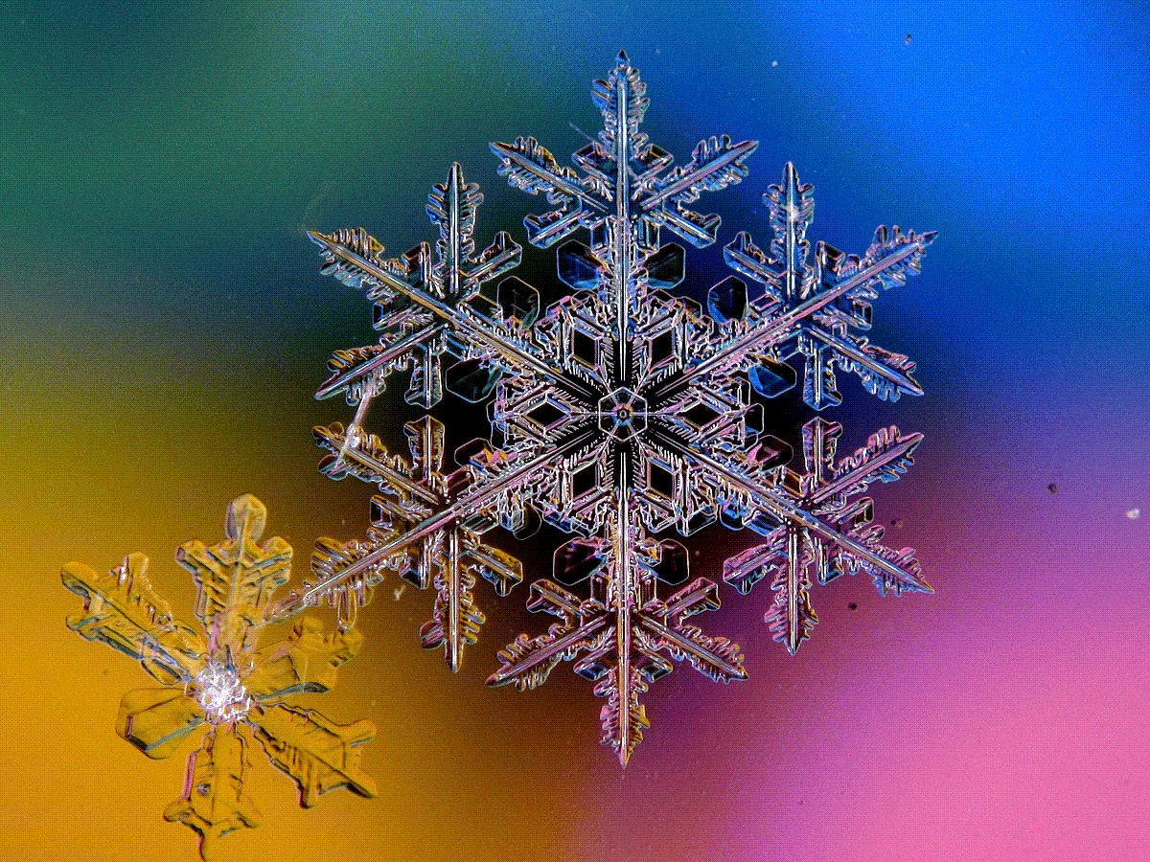
Conclusion
What models are we currently implementing?

Slide 16

THANK YOU!
Any Questions

Slide 17

HOW TO USE THIS PRESENTATION
Google Slides
PowerPoint
Canva
Click on the "Google Slides" button below this presentation preview.
Click on "Make a copy."
Start editing your presentation.
You need to sign in to your Google account.
Click on the "PowerPoint" button below this presentation preview.
Start editing your presentation.
Download and install the fonts used in this presentation as listed on the next page.
Click on the "Canva" button under this presentation preview.
Start editing your presentation.
You need to sign in to your Canva account.

Slide 18

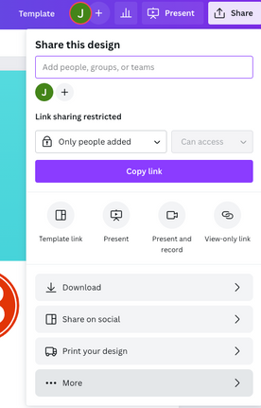
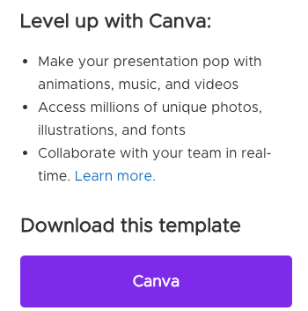
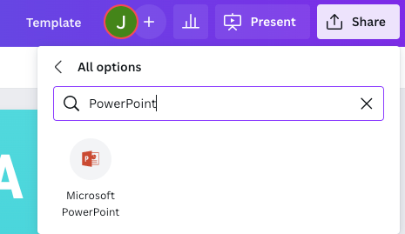
DOWNLOAD THIS PRESENTATION AS
A POWERPOINT TEMPLATE IN 3 STEPS
1
2
3
Click on the "Canva" button next to this presentation. Start editing your presentation. You may need to sign in to your Canva account.
Click on the "Share" button on the top right corner in Canva and click on "More" at the bottom of the menu.
Enter "PowerPoint" in the search bar and click on the PowerPoint icon to download.

Slide 19
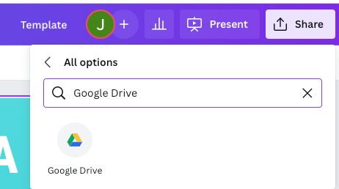
DOWNLOAD THIS PRESENTATION AS
A GOOGLE SLIDE TEMPLATE IN 3 STEPS
1
2
3
Click on the "Canva" button next to this presentation. Start editing your presentation. You may need to sign in to your Canva account.
Click on the "Share" button on the top right corner in Canva and click on "More" at the bottom of the menu.
Enter "Google Drive" in the search bar and click on the Google Drive icon to add this design as a Google slide in your G Drive. It will ask you to link your Google account to Canva the first time.

Slide 20
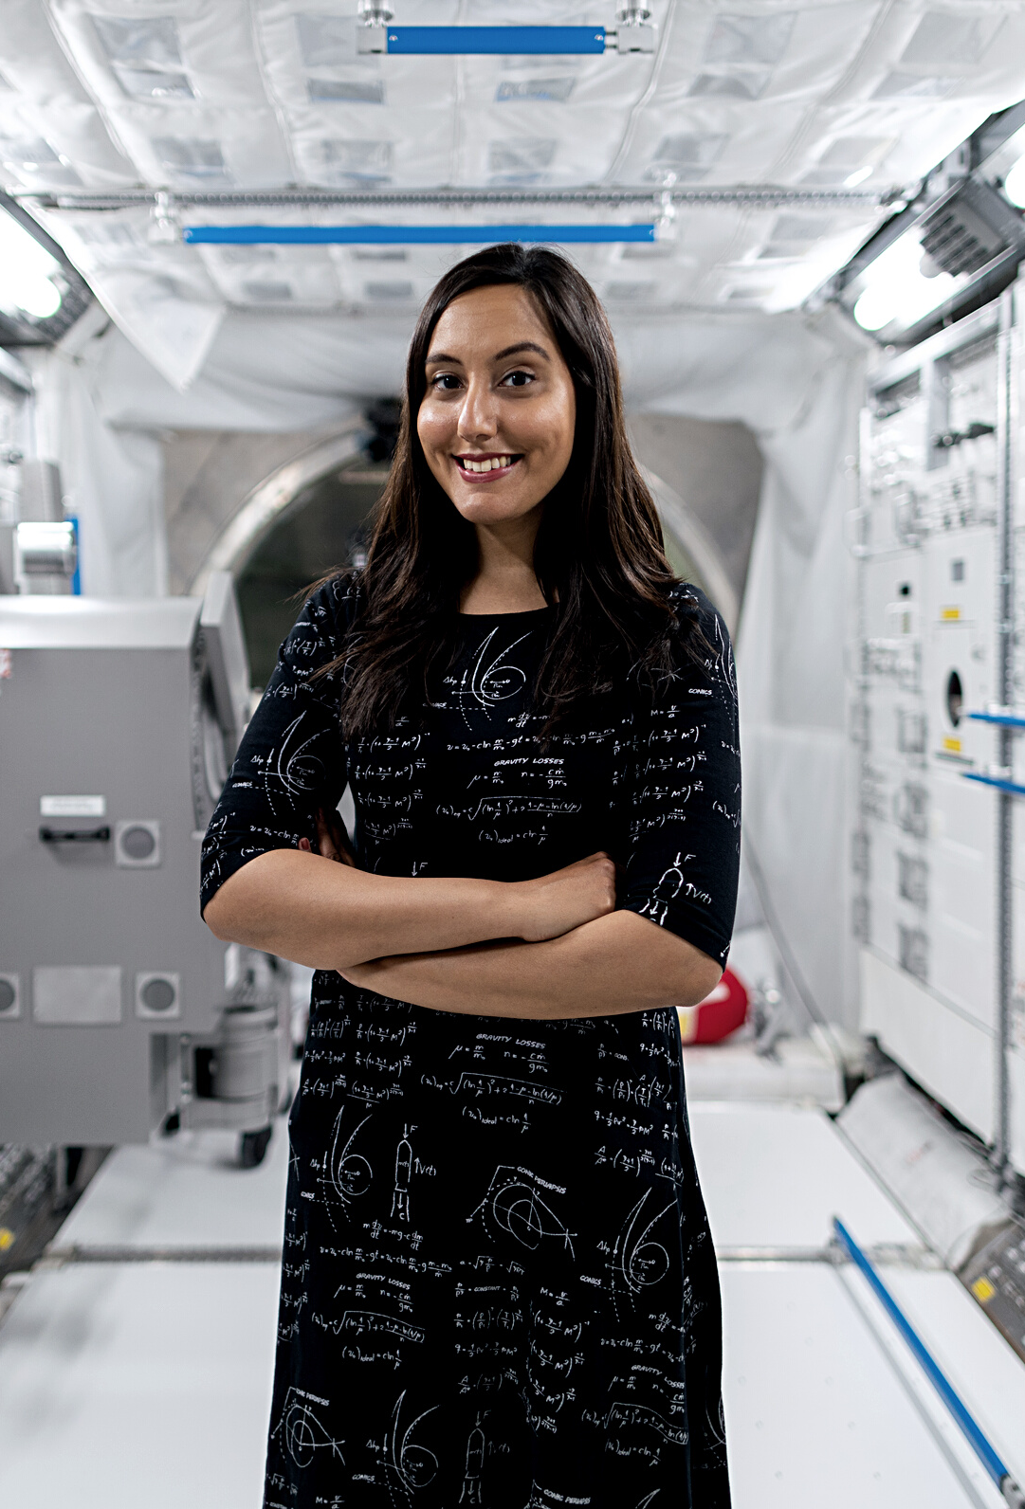
HELLO THERE!
I'm Rain. Welcome to my education presentation.
Follow me at @reallygreatsite to
learn more.

Slide 21


WRITE YOUR TOPIC OR IDEA
Elaborate on what you want
to discuss.

Slide 22


"
WRITE AN ORIGINAL STATEMENT OR INSPIRING QUOTE
— Include a credit, citation, or supporting message

Slide 23

WRITE YOUR TOPIC OR IDEA
Add a main point
Add a main point
Add a main point
Briefly elaborate on what you want to discuss.
Briefly elaborate on what you want to discuss.
Briefly elaborate on what you want to discuss.

Slide 24
THEORY 1
Elaborate on what you want to discuss.
WRITE YOUR THEORETICAL FRAMEWORK
THEORY 2
Elaborate on what you want to discuss.
THEORY 3
Elaborate on what you want to discuss.

Slide 25
WRITE YOUR TOPIC OR IDEA
Add a main point | Elaborate on what you want to discuss.
Add a main point | Elaborate on what you want to discuss.
Add a main point | Elaborate on what you want to discuss.
Add a main point | Elaborate on what you want to discuss.
Add a main point | Elaborate on what you want to discuss.

Slide 26

STUDY OBJECTIVES
Add an objective
Add an objective
Add an objective
Elaborate on what you want to discuss.
Elaborate on what you want to discuss.
Elaborate on what you want to discuss.

Slide 27
2 OUT
OF 5
12 MILLION
95%
Elaborate on the featured statistic.
Elaborate on the featured statistic.
Elaborate on the featured statistic.

Slide 28
WRITE YOUR TOPIC OR IDEA
1ST QUARTER
January
Double click to add task
February
Double click to add task
March
Double click to add task
2ND QUARTER
April
Double click to add task
May
Double click to add task
June
Double click to add task
3RD QUARTER
July
Double click to add task
August
Double click to add task
September
Double click to add task
4TH QUARTER
October
Double click to add task
November
Double click to add task
December
Double click to add task

Slide 29

WRITE A HEADING HERE

Slide 30


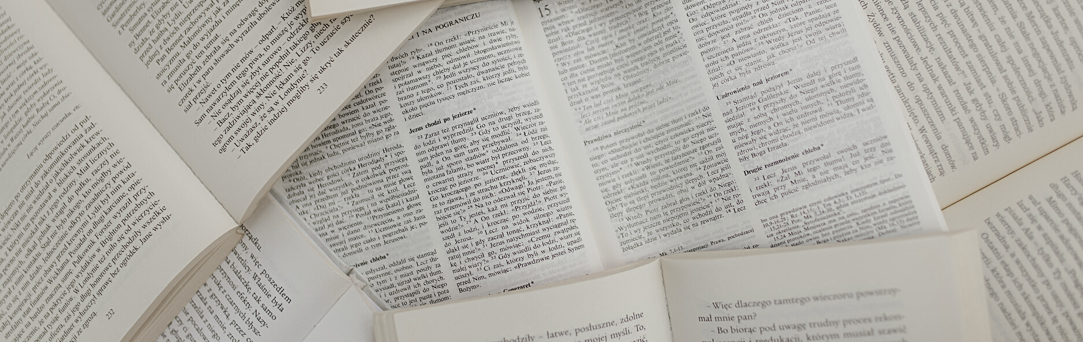
Write a caption for the photos.

Slide 31


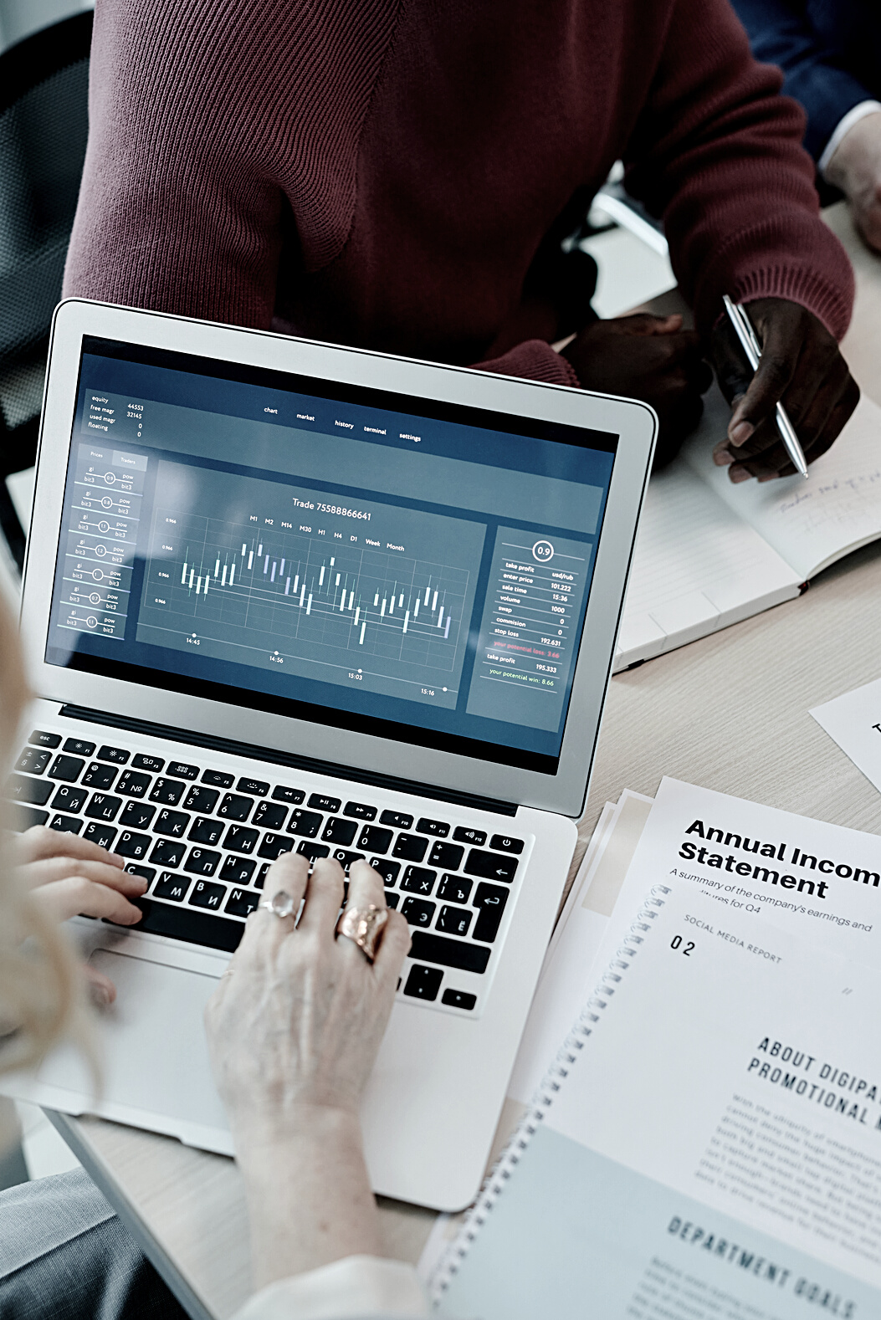

Name
Name
Name
Name
Title or Position
Title or Position
Title or Position
Title or Position
ADD A TEAM MEMBERS PAGE
Elaborate on what you want to discuss.

Slide 32
ADD A TIMELINE PAGE
ADD A MAIN POINT
Elaborate on what you want to discuss.
ADD A MAIN POINT
Elaborate on what you want to discuss.
ADD A MAIN POINT
Elaborate on what you want to discuss.

Slide 33
S
W
O
T
STRENGTHS
WEAKNESSES
OPPORTUNITIES
THREATS
What are you
doing well?
What sets you apart?
What are your
good qualities?
Where do you need to improve?
Are resources adequate?
What do others do better than you?
What are your goals?
Are demands shifting?
How can it
be improved?
What are the blockers you're facing?
What are factors outside of
your control?

Slide 34
ANALYSIS OF THE RESULTS
25
20
Discuss the results of the research.
15
10
5
0
Item 1
Item 2
Item 3
Item 4
Item 5

Slide 35
METHODOLOGY
Add a topic
Add a topic
Add a topic
Add a topic
Add a topic
Add a topic
Add a topic
Add a topic

Slide 36

GET IN TOUCH
Email
hello@reallygreatsite.com
Social Media
@reallygreatsite
Call us
123-456-7890

Slide 37
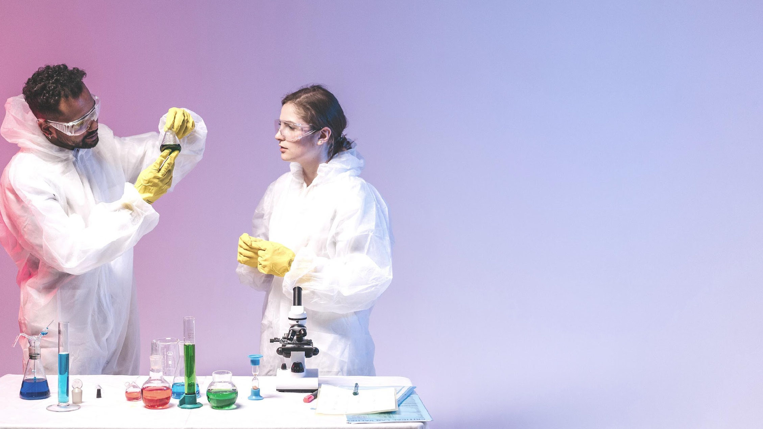
FONTS IN THIS PRESENTATION
This presentation template uses the following free fonts:
Titles: Forum
Headers: Sarabun
Body Copy: Sarabun
You can find these fonts online too.
Happy designing!

Slide 38
CREDITS
This presentation template is free for everyone to use thanks to the following:
SlidesCarnival for the presentation template
Pexels for the photos
HAPPY DESIGNING!

Slide 39
RESOURCE
PAGE
Use these design resources in your Canva Presentation. Happy designing!
Don't forget to delete this page before presenting.

Slide 40







































RESOURCE
PAGE
Use these design resources in your Canva Presentation. Happy designing!
Don't forget to delete this page before presenting.

Slide 41

FREE TEMPLATES FOR ALL YOUR PRESENTATION NEEDS
For PowerPoint, Google Slides, and Canva
100% free for personal or commercial use
Ready to use, professional, and customizable
Blow your audience away with attractive visuals

